Slide 1
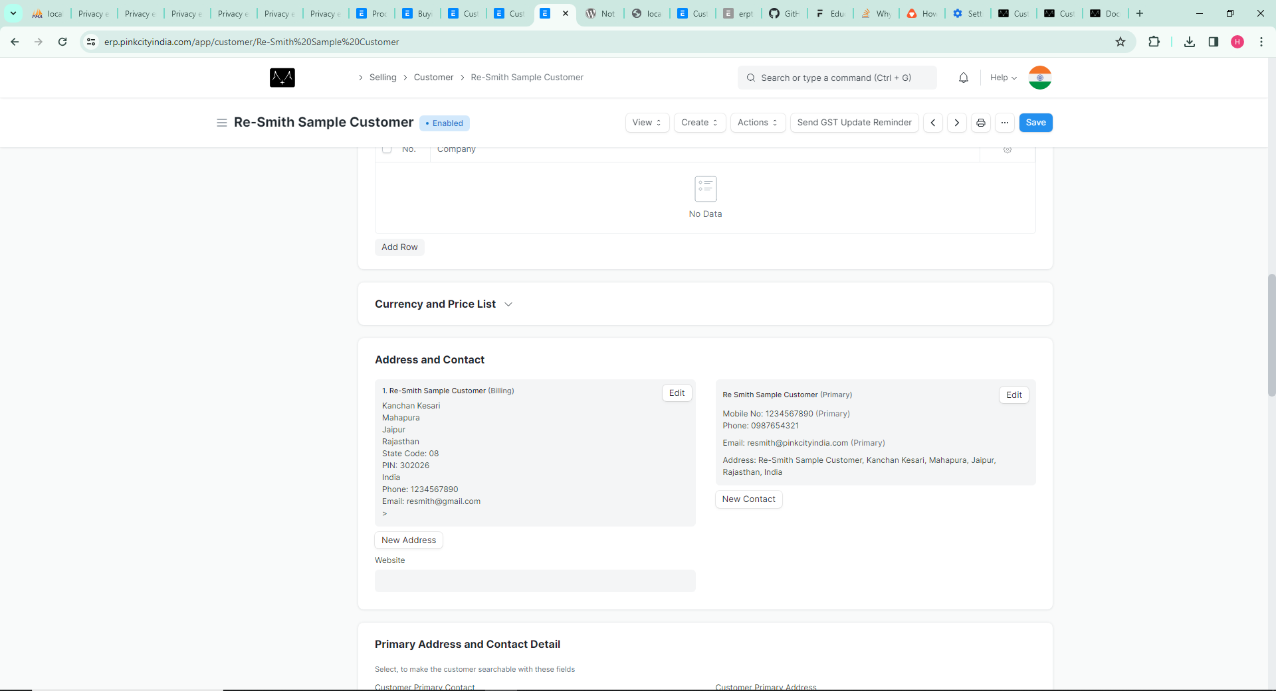
Address and Contact part on Customer
Customer address & contact details

Slide 2
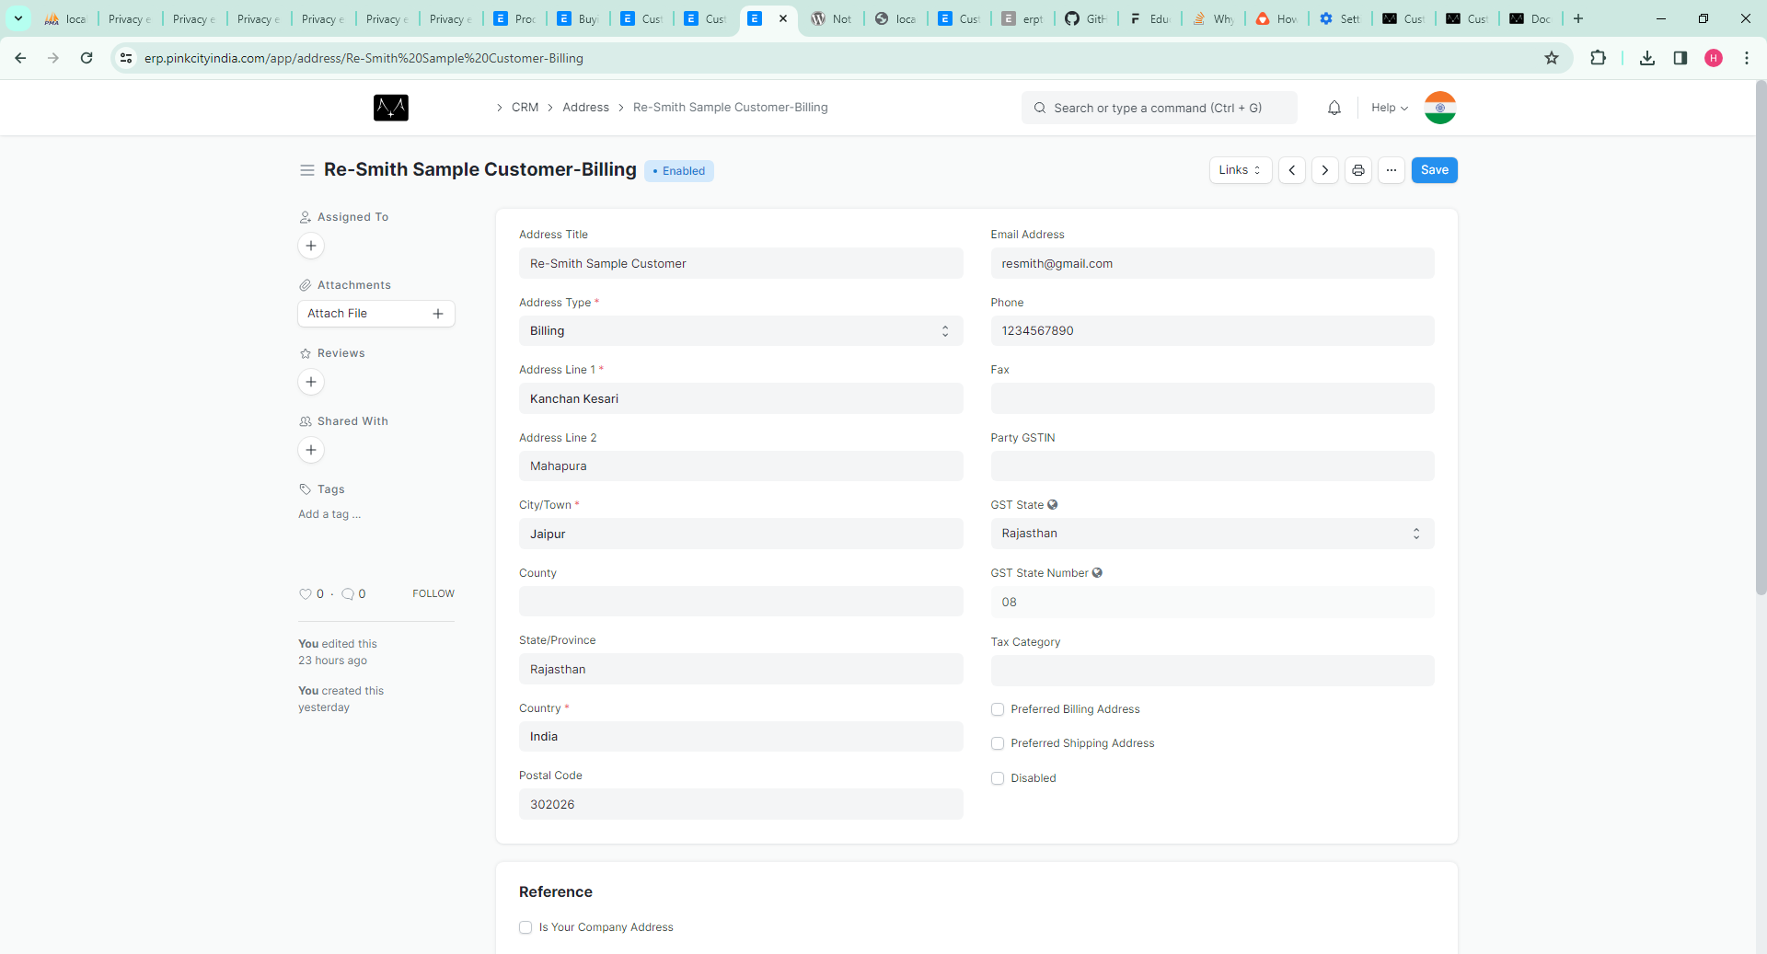
Customer Address Form
Customer address

Slide 3
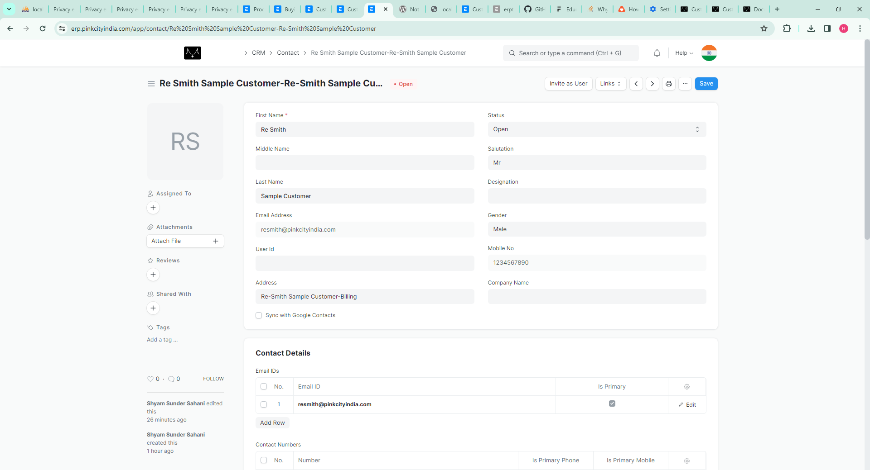
Customer Conatct Form - part 1
Customer contact

Slide 4
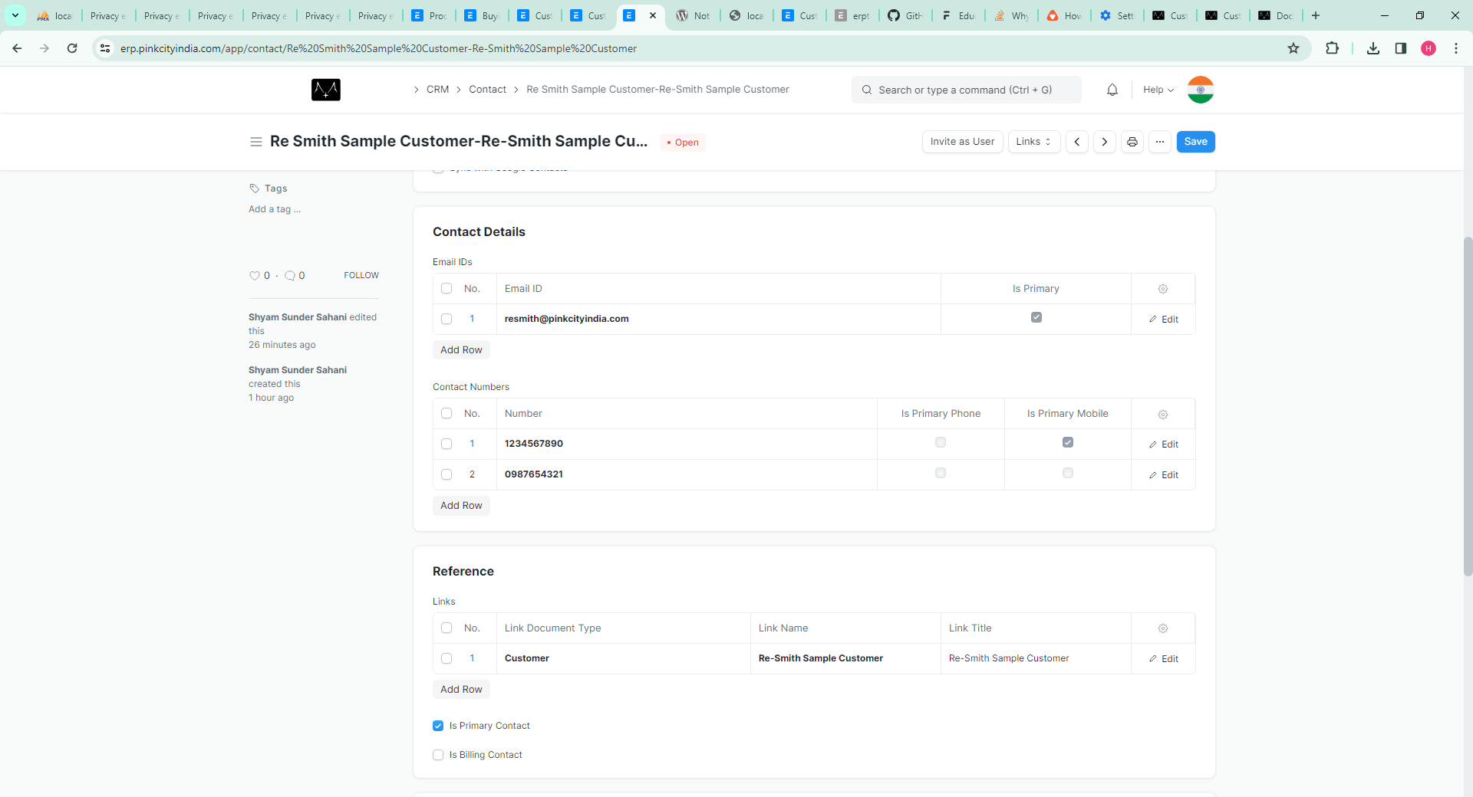
Customer Contact Form - part 2
Mark primary
one Email
and
Mobile no Here

Slide 5
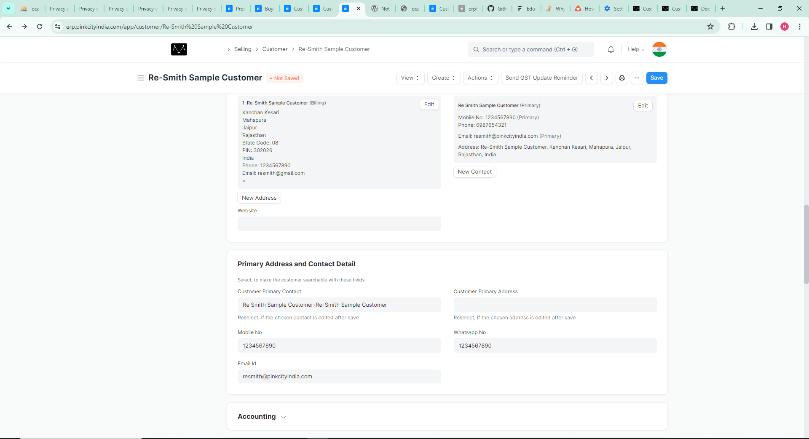
You can select
Primary Contact Details
and
Address
from here

Slide 6
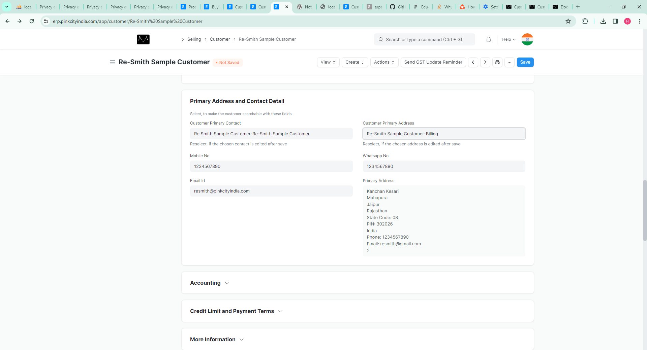
In case whatsapp no is
different then primary
Fetch from Contact Form,
where mobile no
and email are
mark as promary
Fetch from Address Form,
where mark as primary

Slide 7
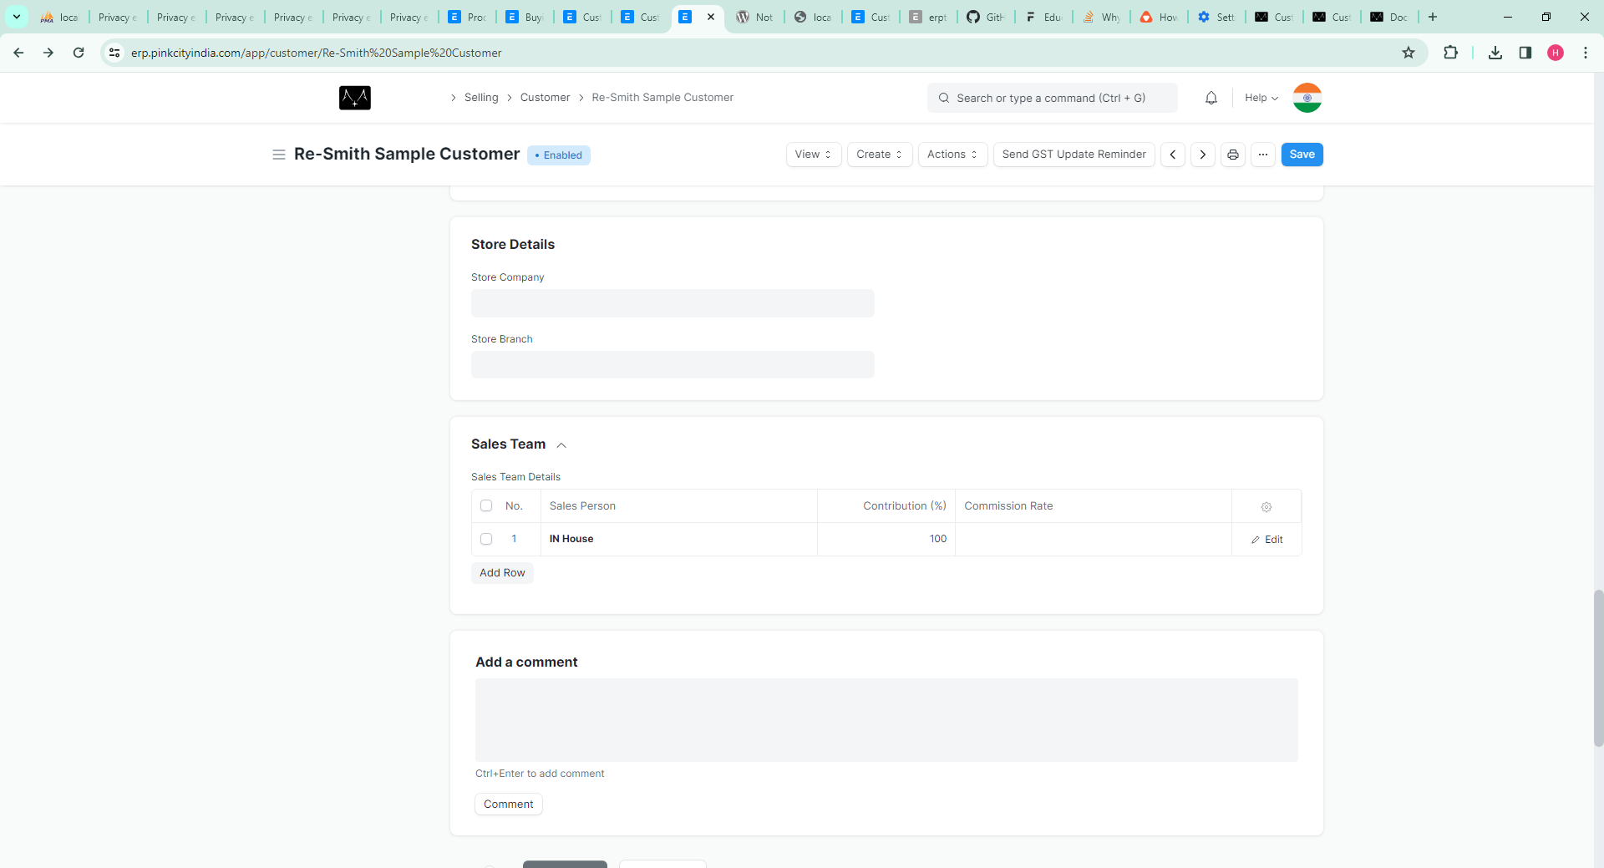
Customer Resmith Store and Branch Details

Slide 8
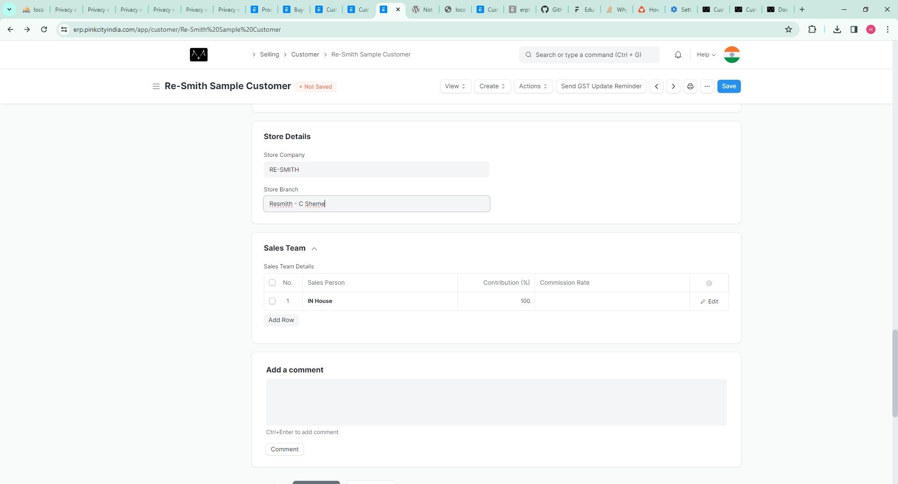
Customer Resmith Store and Branch Details : Example

